Slide 1


Mikhail Dziarbeyeu
Junior Software Engineer
July, 2018

Slide 2
Self-Introduction
Software Engineer with 1-year experience in front-end and mobile development.
Core skills:
Development of mobile-oriented solutions (React Native).
JS frameworks (ReactJS, Redux).

Slide 3

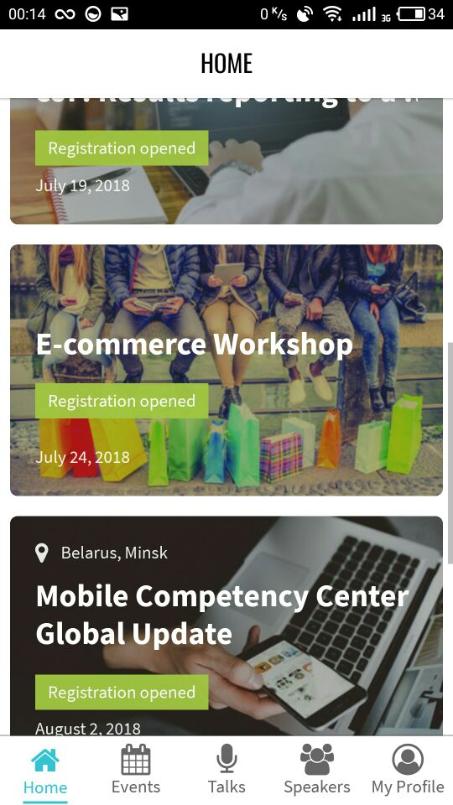
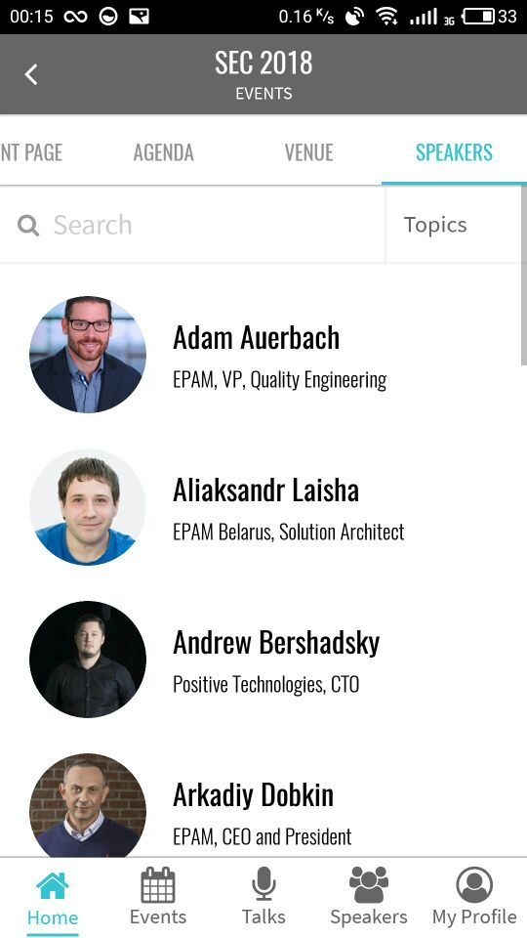
Project
EVENTS MOBI
Mobile version of EPAM events platform. You can find EPAM events happening around you. Full information about events calendar, speakers, venues and navigation, talks streams/recordings and much more in one app.

Slide 4
Project participation and activities
Client-side development
Creating UI building blocks
Map integration
Video integration
Creating native modules
Chat
Scrum

Slide 5
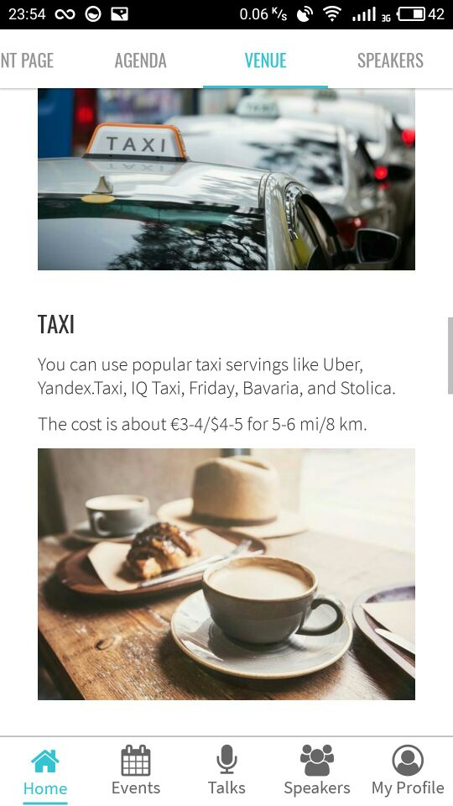
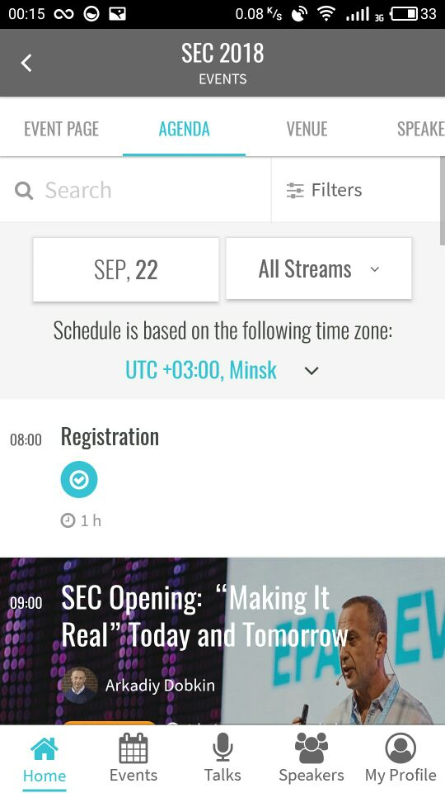
Creating UI bulding blocks
Work on our project is built in such a way that every developer is working on creating a markup of components and on filling them with certain functional logic.

Slide 6
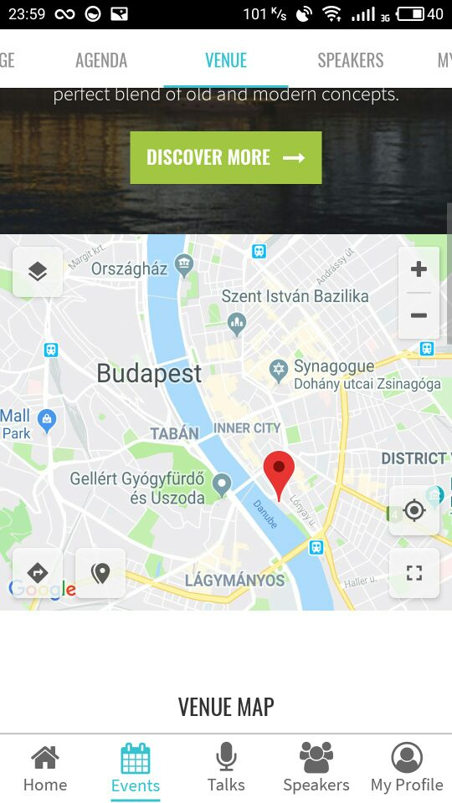
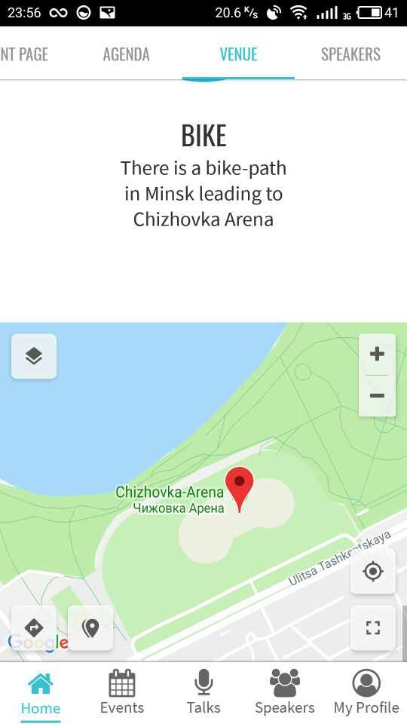
Map integration
To be able to display event venues on the map, we have integrated a Google map in the application and added custom controls for it.

Slide 7
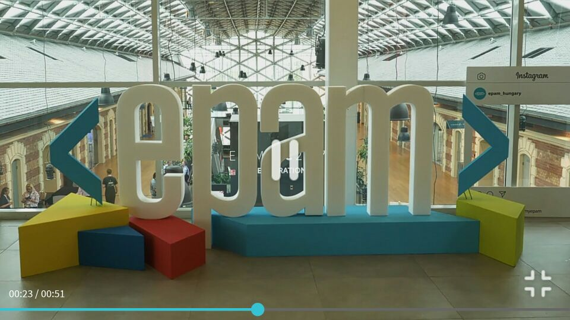
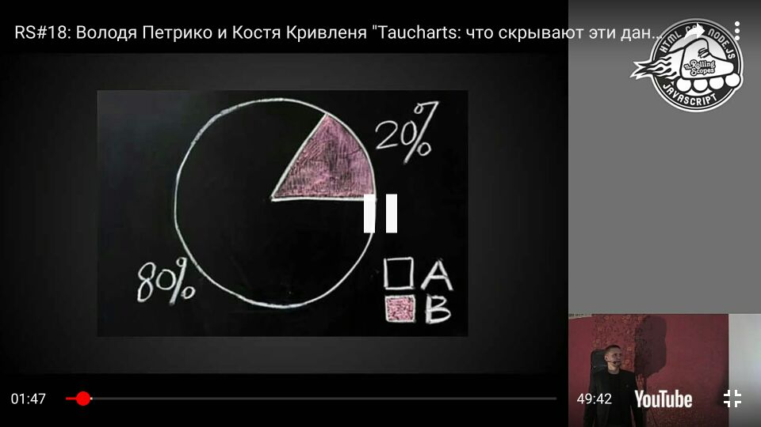
Video integration
One of the key features of EVENTS MOBI is an opportunity to view the content of EPAM video portal and YouTube. We needed:
Custom player design.
Process various edge-cases (content unavailability, stream interruptions, etc.)
Fullscreen mode support.
“Autofullscreen” when rotating a device like in YouTube application
A custom video player was created to satisfy all the above mentioned requirements.

Slide 8
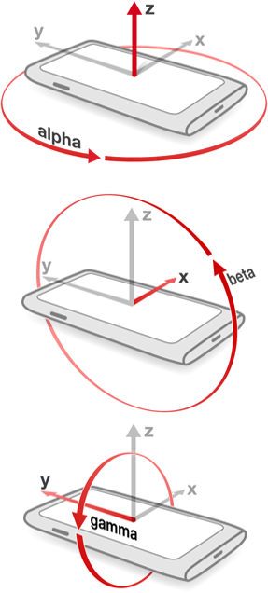
Creating native modules
To fulfill “autofullscreen” feature, we have implemented a native module which calculate the actual orientation of the device according to accelerometer data (pitch, roll, azimuth).
It allowed us to trigger fullscreen at the right time without unlocking the application layout.
As a result, we have got smooth and fast animations of fullscreen transitions.

Slide 9
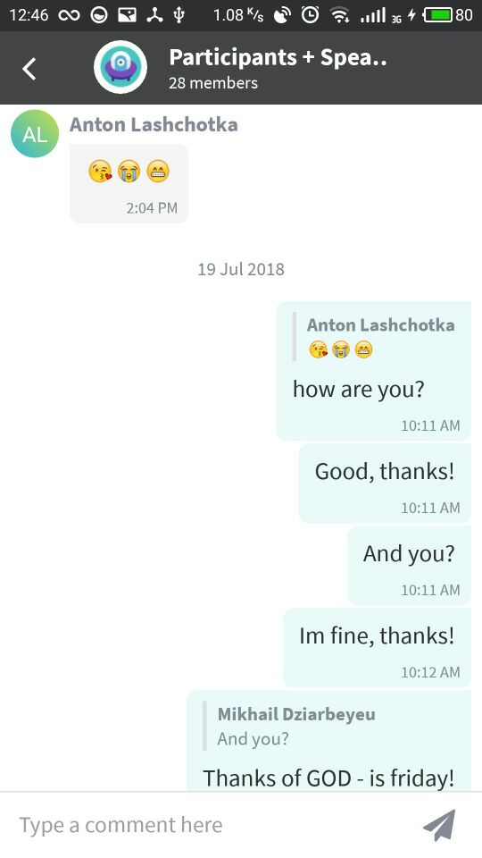
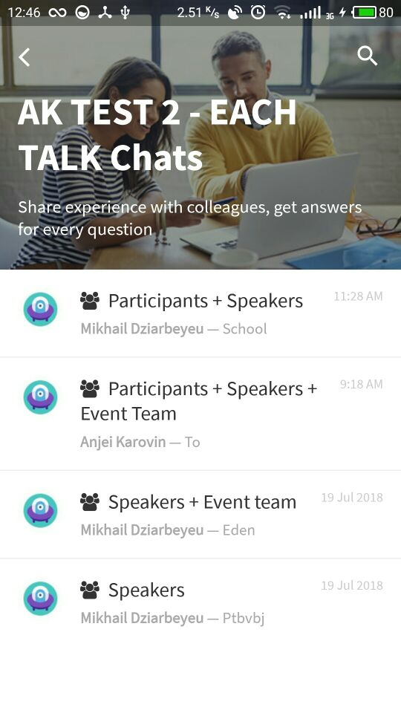
Chat
I was assigned a task to create a chat based on web sockets.
In the upcoming releases the chat feature will be added to the application.

Slide 10
Non-project activities
Mentor:
The Rolling scopes school
React native mentoring program
React native for Armenia
Mentee:
NodeJS Global Mentoring Program

Slide 11

THANK YOU

